Slide 1
Object-Oriented Thinking

Slide 2
Different paradigms for problem solving
Paradigm can be termed as method to solve some problem.
Programming paradigms are the various approaches to solve a problem.
Advantage:-Knowing those approaches will help us to choose the right paradigm based on the problem.
Apart from varieties of programming language there are lots of paradigms to fulfill each and every demand.

Slide 3
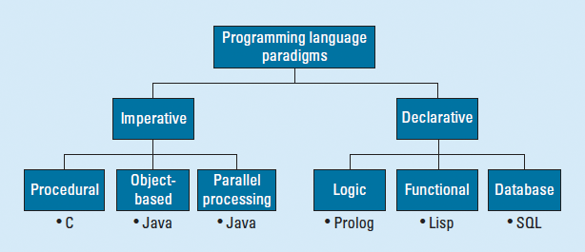
Programming paradigms

Slide 4
Primary programming paradigms.
There are two primary programming paradigms.
1. An imperative programming paradigm.
2. Declarative programming Paradigm
Notes:
Informing the computer what to do next.
Analogy:
In the restaurant, and while ordering your food, you don’t just choose the dish, but you also give instructions to the chef on how to prepare the dish. The steps and sequences are explicitly given in the imperative type of paradigm.

Slide 5
An Imperative programming paradigm
It’s main Emphasis on explicit control flow.
The programmer itself explicitly defines the order of execution of the instructions.
It performs step by step task by changing state.
The main focus is on how to achieve the goal.
The paradigm consist of several statements and after execution of all the result is stored.
Ex:- C,C++ ,Java , PHP , Fortran and Basic
Ex:- int a=2, b=3;
int total= a+b;

Slide 6
Declarative programming Paradigm
It expresses logic of computation without talking about its control flow.
Imperative says how to do it.
Declarative says what to do.
It just declare the result we want rather how it has be produced.
Ex:- Prolog, SQL
→select name from vegetables;
Notes:
we use query select name from vegetables; as an instruction to get information about the name of all vegetables, we didn’t tell the computer how to get the information.

Slide 7
Categories of Imperative programming
Imperative programming is divided into three broad categories:
1. Procedural programming paradigm
2. Object oriented programming
3. Parallel processing approach

Slide 8
Procedural Paradigm
It emphasizes on procedure.
There is no much difference between procedural and imperative approach.
Procedures also known as routines, subroutines, or functions, simply contain a series of computational steps to be carried out.
Advantages of Procedural Programming:
→The code becomes reusable.
→It is easier to keep track of the control flow.
Examples :- C, C++, Java , PHP, Pascal etc
Notes:
Procedures are also known as routines, subroutines, methods, or functions. Adds reusability..

Slide 9
Object-Oriented Programming
It is based on the concept of objects.
An object can be any real-world entity.
More emphasis is on data rather than procedure.
It can handle almost all kind of real life problems which are today in scenario.
That provides many benefits such as –
→Reusability through Inheritance
→Security through Encapsulation
→Flexibility through Polymorphism
→Hiding the complexity or hiding implementation details through Abstraction
EX Languages:- C++, Java and Python, simula, smalltalk
Notes:
C++ is not pure oop language. Real world entity (obj)as a unit.. Which internally encapsulate data n related fn’s

Slide 10
Parallel processing approach
It is the processing of program instructions by dividing them among multiple processors.
A parallel processing system posses many numbers of processor with the objective of running a program in less time by dividing them.
This approach seems to be like divide and conquer.
Ex Languages: NESL, C/C++
Notes:
NESL- A PARALLEL PROGRAMMING LANGUAGE
C++- PASL-- The Property Set Library (PSL) is a template-based C++ container library providing value observation, event calling, thread-safety, garbage collection, serialization,
In C – Pthreads can be used for parallel programming

Slide 11
Categories of Declarative programming paradigm
Declarative programming paradigm is divided into 3 categories:
Functional programming paradigms
Logic programming paradigms
Database/Data driven programming approach

Slide 12
Functional Paradigm
It Has its roots in Mathematics.
Language Independent.
Key Principle: Execution of series of mathematical functions.
The central model for the abstraction is the function which are meant for some specific computation and not the data structure.
Function hide their implementation.
Function can be replaced with their values without changing the meaning of the program.
Ex languages: Perl, JavaScript
Notes:
No side effect means the function doesn’t change the value of any variable, which is outside of its scope. This approach leaves the system in the same state as it was before calling the function.
Most of the functional programming support features like higher-order functions, lambda functions, anonymous functions, closures, function recursion, etc. to give more power to function.

Slide 13
Logical Paradigm
In logical programming the main emphasize is on knowledge base(which we know before) and the problem given to machine will give you the result.
while using the concept of AI, ML we have some models like Perception model which is using the same mechanism.
Ex Language :- Prolog
[Prolog is a logic programming language associated with artificial intelligence]

Slide 14
Database/Data driven programming approach
It is based on data and its movement.
Program statements are defined by the DATA,
rather than hard-coding a series of steps.
A database program is the heart of a business information system and provides
- file creation
- data entry
- update
- query
There are several programming languages that are developed mostly for database applications.
Ex:- SQL

Slide 15
Need for OOP paradigm
C++ was developed by Bjarne Stroustrup as an extension of the C language.
An object-oriented programming is a way of programming which enables programmers to think like they are working with real-life entities or objects.
Features of Object-Oriented Programming:
→Inheritance
→Data binding/Encapsulation
→Polymorphism
→Abstraction
Notes:
In real-life, people have knowledge and can do various works. objects have fields to store knowledge/state/data and can do various works — methods

Slide 16
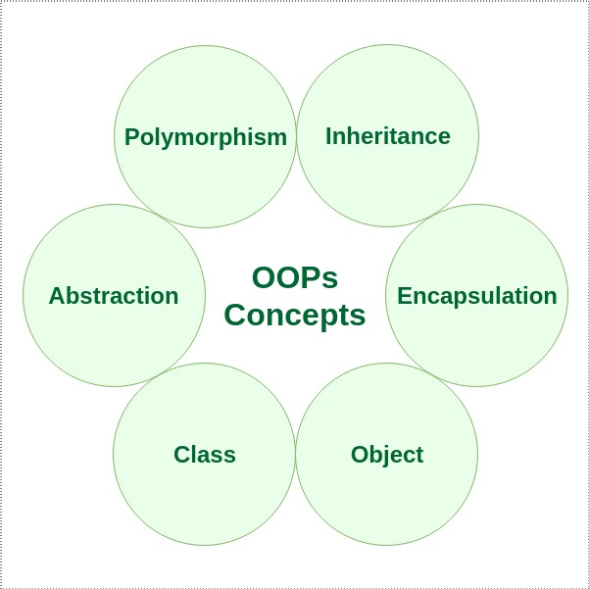
Features of OOP Language

Slide 17
Class
Class is a blue-print representing a group of objects which shares some common properties and behaviors.
When a class is defined, no memory is allocated.
Class is similar to structures.
It’s an abstract data type and user defined data type.
Ex:- The Class of Cars.
Properties - wheels, speed limits, mileage etc
Behavior- apply brakes, increase speed etc

Slide 18
Example of Class
class student
{
int rno;
char name[30];
public:
void read()
{}
void write(){}
void display(){}
};
Notes:
E:\2019-20\SEM-1 CPP\C++ CLASS PROGS\Unit 1\CPP-UNIT-1 PROG'S\classes1\classes1 programs should explain
Default Access specifier in Structure is public. Difference between structure and class should tell.

Slide 19
Object
Object is an instance of a Class.
When an object is created memory is allocated.
Ex: class Student
{
int id;
char name[20];
public:
void getdetails(){}
};
int main()
{
Student s1; // s1 is a object
}

Slide 20
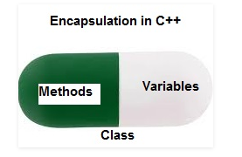
Encapsulation
Encapsulation is defined as binding together the data and the functions that manipulates them.
Data abstraction or Data hiding can be achieved through Encapsulation.
It can be achieved by using Access specifiers.
Ex:- Class

Slide 21
Abstraction
Abstraction means displaying only essential information and hiding the background details/ Implementation details.
Ex:- Man driving a car.
Abstraction can be 2 types:
Abstraction using Classes
Abstraction in Header files
Notes:
A Class can decide which data member will be visible to the outside world and which is not.---- Data Absraction
consider the pow() method present in math.h header file.------------Abstraction in Header files

Slide 22
Polymorphism
Polymorphism: The word polymorphism means having many forms.
Ex:- Person
Two types of Polymorphism are available in C++-
1.Compile time polymorphism / Early binding
- function overloading, constructor and operator overloading
2. Run time polymorphism / Late binding
-function overriding (Achieved through Inheritance)
Notes:
A person can be a father , Husband and an employee. So the same person posses different behaviour in different situations. This is called polymorphism. The operator overloading exceptions are . (dot) :: ?: sizeof

Slide 23
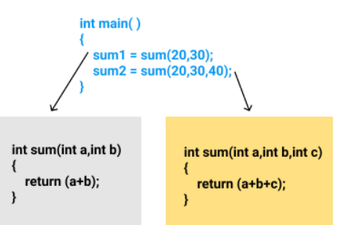
contd…
Example of Function overloading:-

Slide 24
Inheritance
One Class acquires all the properties and behaviors of its parent Class automatically.
The class which inherits the members of another class is called derived class.
The class whose members are inherited is called base class.
Is a Relationship is maintained between Super class and Sub class,
Advantage of C++ Inheritance:
→Code reusability
→Extensibility

Slide 25
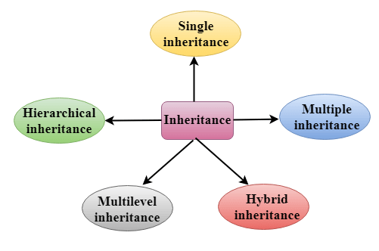
contd…
C++ supports five types of inheritance:

Slide 26
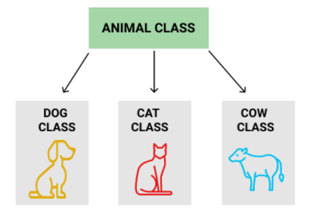
contd..
Example: Dog, Cat, Cow can be Derived Classes of Animal Base Class.

Slide 27

Single Inheritance

Slide 28

Multilevel Inheritance

Slide 29
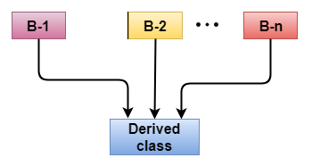
Multiple Inheritance

Slide 30
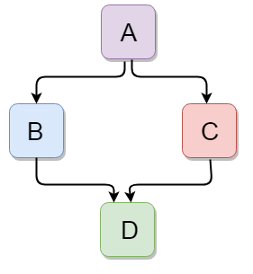
Hybrid Inheritance

Slide 31
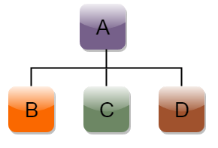
Hierarchical Inheritance

Slide 32
Differences between OOP and Procedure oriented programming
POP In procedural programming, program is divided into small parts called functions. | OOP In object oriented programming, program is divided into small parts called objects.
Procedural programming follows top down approach. | Object oriented programming follows bottom up approach.
There is no access specifier in procedural programming. | Object oriented programming have access specifiers like private, public, protected etc.
Adding new data and function is not easy. | Adding new data and function is easy.
Notes:
POP:In top down approach, main() function is written first and all sub functions are called from main function.
Related with the conventional style. This approach is also known as the top-down approach. In this approach, a program is divided into functions that perform specific tasks. This approach is mainly used for medium-sized applications. Data is global, and all the functions can access global data. The basic drawback of the procedural programming approach is that data is not secured because data is global and can be accessed by any function. Program control flow is achieved through function calls and go to statements.
bottom level modules developed first in Bottom-up Approach

Slide 33
contd…
Procedural programming does not have any proper way for hiding data so it is less secure. | Object oriented programming provides data hiding so it is more secure.
In procedural programming, overloading is not possible. | Overloading is possible in object oriented programming.
In procedural programming, function is more important than data. | In object oriented programming, data is more important than function.
Procedural programming is based on unreal world. | Object oriented programming is based on real world.
Examples: C, FORTRAN, Pascal, Basic etc. | Examples: C++, Java, Python, C# etc.

Slide 34
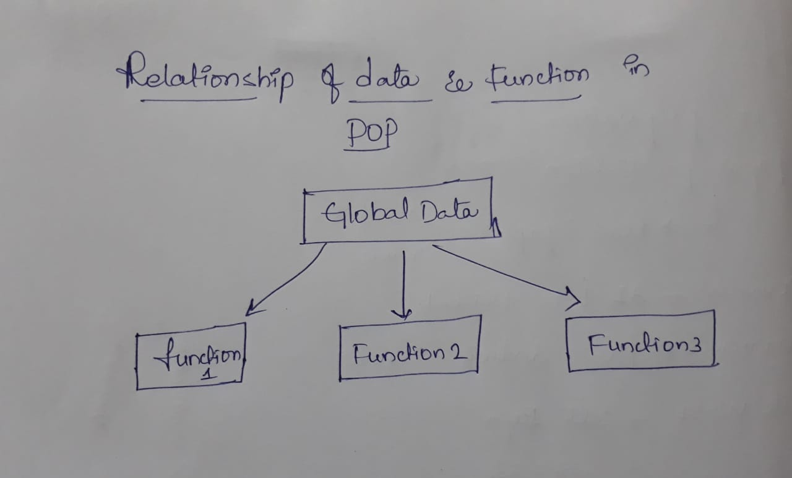
Relation of Data & Functions in POP

Slide 35
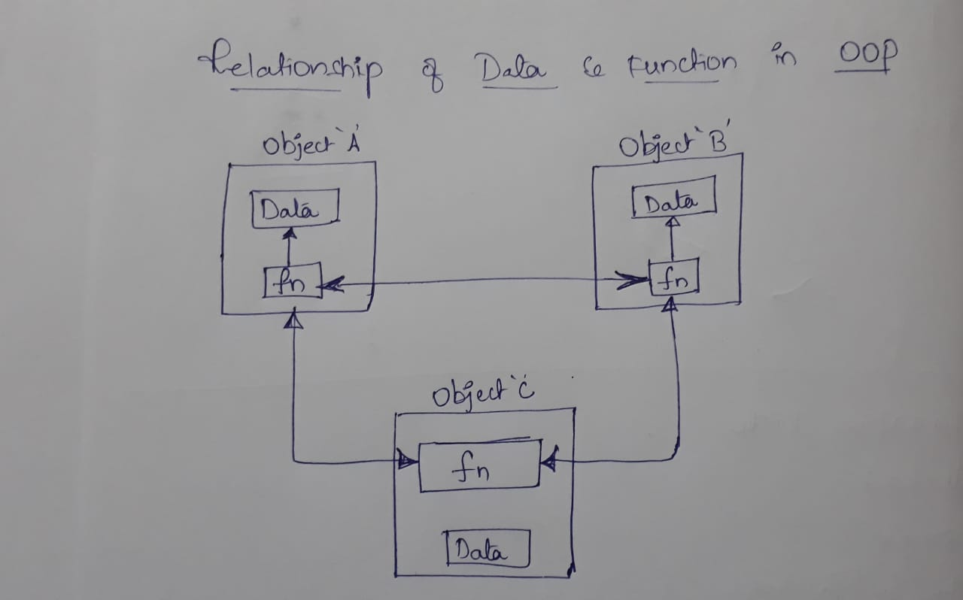
Relation of Data & Functions in OOP

